Slide 1
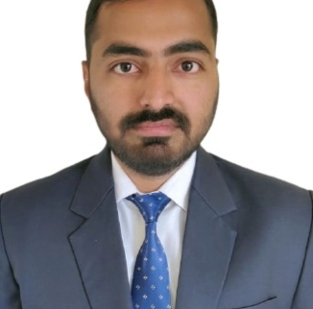

Nishant Kumar Mishra
Bachelor of Technology
Computer Science : 2017 - 2021
Skills C,C++
C#
.NET
Database
SQL database – MySQL
No SQL database – MongoDB
Web Technologies
HTML5
CSS3
Javascript
AddOns
Github
Postman
Additional Details
Leadership
Quick Learner
Team management
Analyst/Software Engineer
Bangalore
Nishant-kumar.a.mishra@capgemini.com
8340310884
A4
Software Engineer who is Strong in design and integration with intuitive problem-solving skills. Passionate about implementing and launching new projects.
Ready to learn new technologies and implement them to further improve my knowledge.
Eager to work in a team of dedicated people and serve a key role in the enhancement and development of the project.
Has working knowledge on Angular and Java Microservice Development using Spring framework on an intermediate level.
Movie Management System
Completed end to end case study of movie management system along with JWT authentication, Swagger and payment testing using postman.
HTML CSS JAVASCRIPT for web developers at Coursera
Completed this course with 88% and Designed responsive Restaurant website using HTML5 CSS3 Bootstrap and Javascript.

